Slide 1
Using QI to help our patients and ourselves
11/06/2019
Bob Badgett, MD
Dept Internal Medicine
Dept Population Health
http://badgettrg.github.io/ - https://osf.io/gq9nt/

Slide 2
Two items we are not focusing on

Slide 3

Resilience is fine…but
A word about yoga later…

Slide 4
What is our real goal: thriving
State | Indicators | Prevalence
Thriving Spreitzer, 2005 | Engaged + learning
Engaged Schaufeli, 2002 | “Feelings of energy, absorption at work” | 25% (APA, 2014)
Satisfaction Locke, 1976 | “A pleasurable or positive emotional state resulting from the appraisal of one's job or job experiences” | 50% (GSS; Gallup 2016)
Burnout Maslach, 1982 | Emotional exhaustion, depersonalization | 70% are not burned out (Shanafelt, 2012)

Slide 5
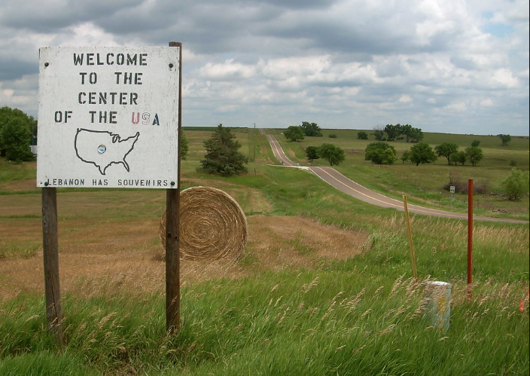

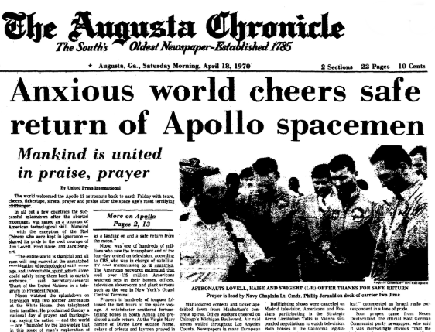
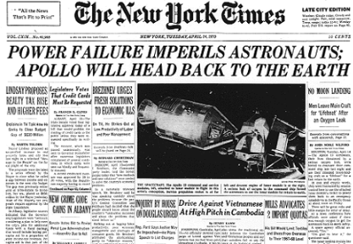
Today…
Bad news
Good news
Big picture
Local picture

Slide 6
Why do we work: aims of health care
Institute for Healthcare Improvement (IHI): Triple Aim
Population’s Health
Population’s Experience of Healthcare
Acceptable per Capita Costs
Institute of Medicine (IOM): AIMS
Safe
Effective (clinically)
Patient-centered
Timely
Efficient
Equitable
Institute of Medicine. Building a Better Delivery System: A New Engineering/Health Care Partnership. 2005
www.ihi.org/offerings/Initiatives/TripleAim/Pages/

Slide 7
4th aim?
Physician wellness: a missing quality indicator?
Wallace, 2009 PMID 19914516
From triple to quadruple aim
Bodenheimer and Sinsky 2014 PMID 25384822
The Quadruple Aim
Sikka, 2015. PMID 26038586
Achieving the Quadruple Aim
O'Connor, 2015. PMID 26357766

Slide 8
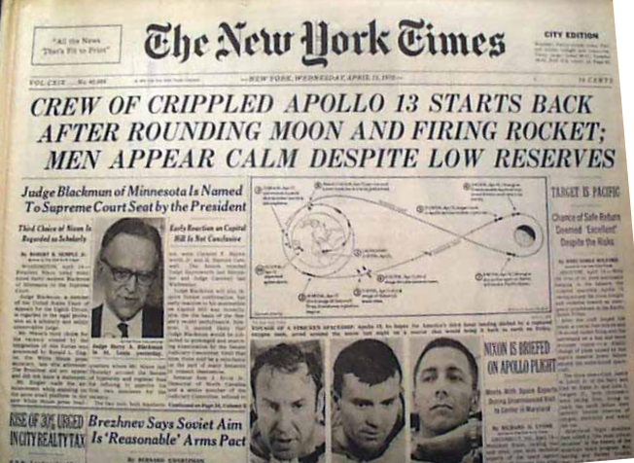
Bad news
Our aim is off target

Slide 9

Problem 1: the quality of care in the USA
We provide 50% of “indicated” care
McGlynn. N Engl J Med 2003 PMID 12826639
Twenty years to disseminate innovation
(Balas, 2000 PMID 27699347)
One third of expenditures may not be needed
Fisher. N Engl J Med 2003 (PMID 14573739).
So…two of 4 aims are lacking
Quality
Cost

Slide 10
Problem 2: we feel miserable
…and 50% of us are burned out (PMID 26653297)
So…3 of 4 aims are lacking
Quality
Costs
Workforce wellbeing

Slide 11
EBM
EBMa: Evidence-based management
47% and 11% of the variation in physician satisfaction and burnout, respectively, at an HCDO could be explained by the leadership score of their immediate supervisor (Shanafelt et al., 2015)
70% of the variance in employee engagement is explained by the actions and behaviors of managers. Gallup (Beck & Harter, 2015)

Slide 12
EBMa: Evidence-based management
Books about the evidence-practice gap by business scholars:
Shut Down the Business School. Parker 2018
Leadership BS. Pfeffer 2016
Managers Not MBAs. Mintzberg 2004
https://www.cebma.org/

Slide 13
It’s going yet worse
As more physicians become employees
HMOs higher burnout. Linzer 2000 PMID 10940129
FQHCs increasing burnout. Freiberg 2017 PMID 28784740
As more hospitals shift to for-profit

Slide 14
The good news
These problems are connected.

Slide 15
The relationship
Quality of care
-
+
Burnout
Engage-ment
& thriving
-

Slide 16
Systematic review: Burnout and clinical quality
Of 114 comparisons
58 indicated burnout related to poor-quality care
50 showed no significant effect
6 indicated burnout related to high-quality care
Tawlik. Ann Intern Med 2019 PMID 31590181

Slide 17
NHS Acute Trusts
Measuring the relationship between hospital staff engagement and mortality: a panel study
Badgett RG, KUSM-W
Jonker L. North Cumbria Trust, Carlisle, UK
Xirasagar S. University of South Carolina
http://doi.org/10.17605/OSF.IO/QX5C2
Panel study with lagged regression analysis

Slide 18
The importance of engagement
Database #1: Survey of 141 acute hospitals over 6 years: UWES-9
“How often do you feel burned out from your work?”
“I am enthusiastic about my job”
“Time passes quickly when I am working”
“I look forward to going to work”
(still not asking about thriving – learning/improving)
Database #2: Adjusted mortality in the NHS over same time period

Slide 19
The importance of engagement
Predicting current engagement | Predicting current SHMI
SHMI, current (Covariate previous engagement) | Engagement, current (Covariate previous SHMI)
-0.07 P = 0.001 R² = 0.5194 | -0.04 p = 0.040 R² = 0.7904
* SHMI. Summary Hospital-level Mortality Indicator.
For to every one who has will more be given, and he will have abundance…
Matthew 25:29; Mark 4:25; Luke 19:26

Slide 20
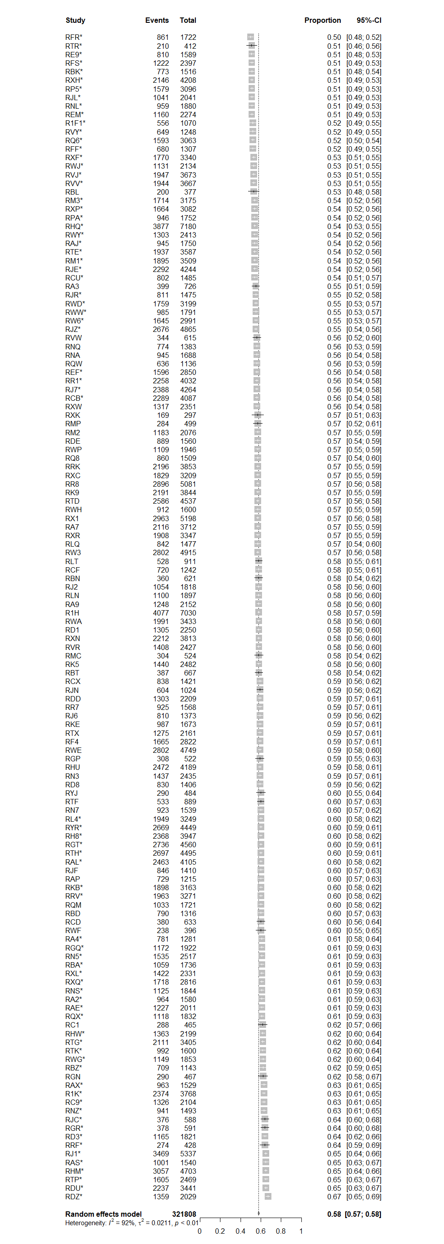
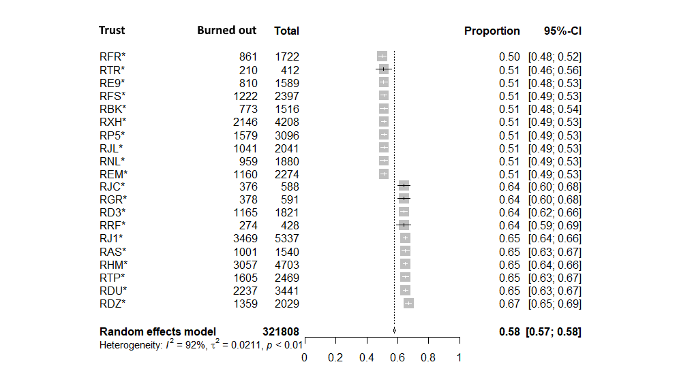
Heterogeneity in engagement
Notes:
136 Trusts

Slide 21
EBM: Evidence-based management (rewind)
Books about the evidence-practice gap by business scholars:
Shut Down the Business School. Parker 2018
Leadership BS. Pfeffer 2016
Managers Not MBAs. Mintzberg 2004
https://www.cebma.org/

Slide 22

Big picture: Organized reporting
Across institutions
Within institutions (not covered today)

Slide 23
Reporting across institutions
Minnesota Hospital Association (data not public)
NHS

Slide 24
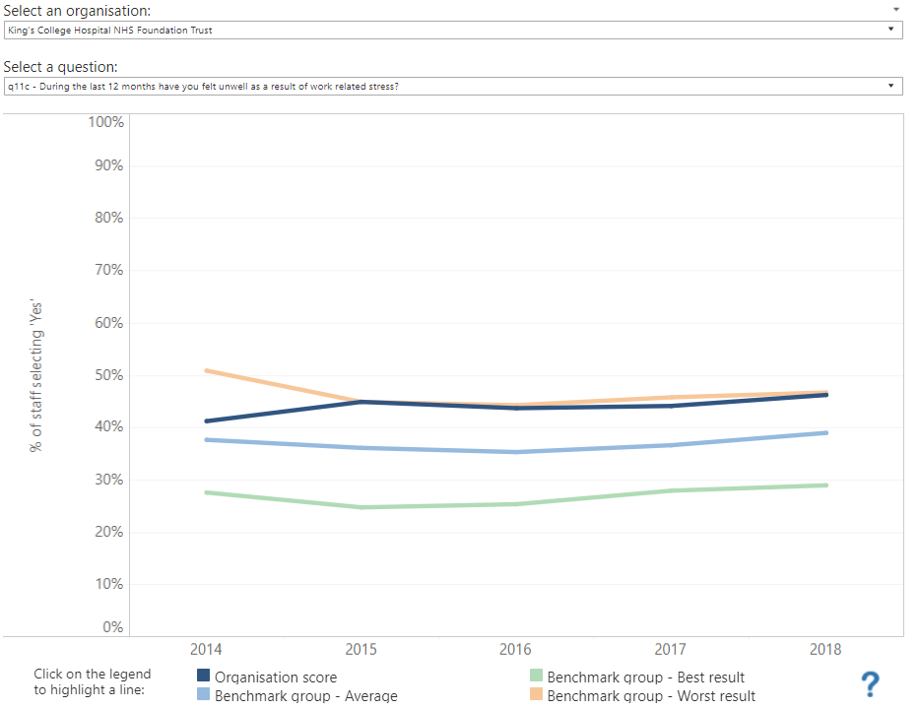
1. Reporting enables: job choice
http://www.nhsstaffsurveyresults.com/national-trend-questions/

Slide 25
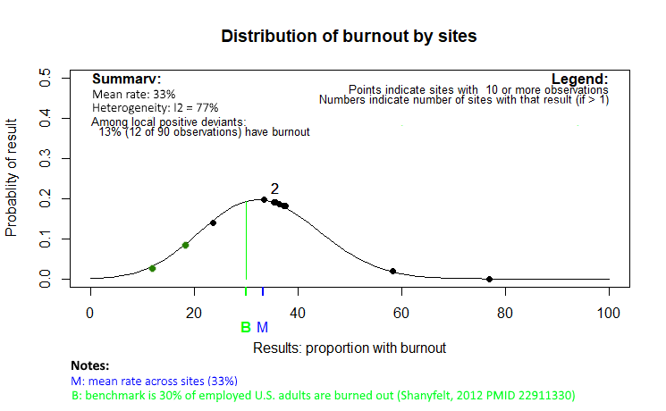
2. Reporting enables: positive deviance intervention

Slide 26
Burnout is not only a healthcare problem
Environmental, social and governance (ESG) investing
“S” includes employee well-being
https://hbswk.hbs.edu/item/should-a-pension-fund-try-to-change-the-world
International Integrated Reporting Council (IIRC)
https://integratedreporting.org
International Standards Organization
https://www.iso.org/committee/6131376.html
(Business Roundtable?)
http://hbswk.hbs.edu/item/has-the-corporate-mission-just-been-disrupted

Slide 27
If the two problems are linked, lets do more QI?
What can we do now???

Slide 28
What do physicians think of QI…
“the E.M.R. has become the convenient vehicle to channel every quandary in health care. New state regulation? Add a required field in the E.M.R. New insurance requirement? Add two fields. New quality-control initiative? Add six.”
Ofri, D. NY Times. Nov 14, 2017
“Quality indices, which are supposed to improve care, ‘are the bane of my existence,’ she says. ‘Many times those numbers reflect not what my patients or I perceive as quality of care, but simply what managers are able to extract from the health record system.’ “
Gunderman R. NEJM Catalyst. Jan 10, 2107

Slide 29
Two types of QI that give control
Enabling / empowering
Positive deviance

Slide 30
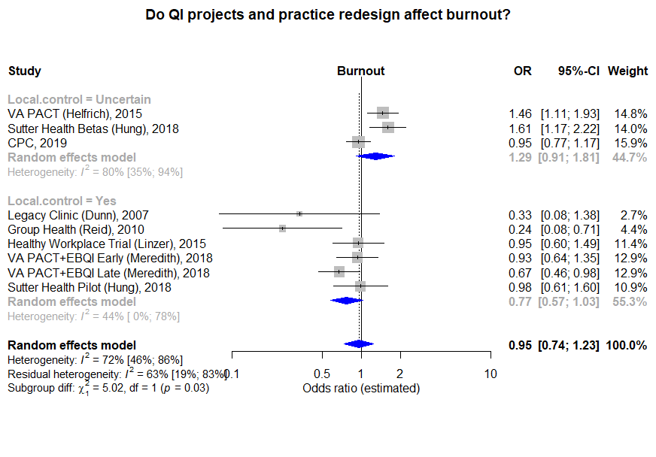
1. Enabling QI
Using empowering leadership to create a climate of employee involvement. Defined as having employees who "mutually understand that they
possess the power to make decisions and act on them,
may access and share the informational resources needed to undertake those actions effectively,
have opportunities to update their knowledge in order to continually develop their effectiveness, and
are rewarded for improving the effectiveness of their work unit and organization“
Wallace. J Management. 2016

Slide 31

2. Positive deviance QI: build community and mastery
Ann Thorac Surg. 2015 PMID 26188970
Notes:
Andrew Seely – identify goals

Slide 32
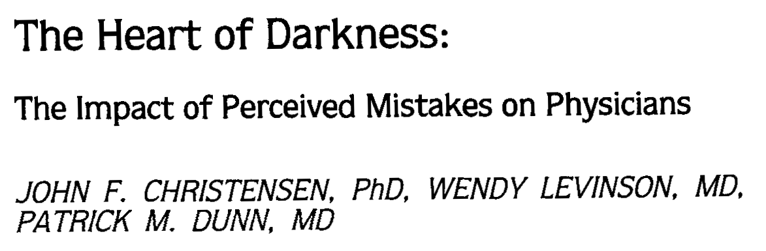
…rather than silos without shared learning…
Audiotaped, in-depth interviews with physicians in which each physician discussed a previous mistake and its impact on his or her life.
J Gen Intern Med. 1992 PMID 1506949

Slide 33

What else can I do now?
Konza Prairie Preserve
If I cannot create
enabling QI or positive deviance QI

Slide 34
Ok, maybe you cannot affect how QI is done locally, but…
Get training for leadership
Be a change agent
Be selective where you work
Be a positive voice
Be an enabler

Slide 35
1. Get training
Basics
Meetings
Email
Spreadsheets and charts
Get comfortable, or at least respectful, of money (PMID 27623461)
But also
Creating change
Enabling leadership (from complexity science)

Slide 36
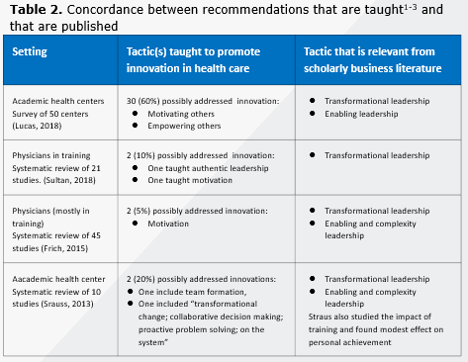
Evidence- practice gap: details

Slide 37
1. Get training
Programs that focus on complexity science
Creating empowerment, learning, change
Self-directed
HBR (subscription after 3 articles/month)
HBS Working Knowledge (free)
Professional organizations
Books about leading a large group
Team of Teams (McChrystal)
Work Rules! (Google’s HR)
Books about leading a small group
Turn the Ship Around! A True Story of Building Leaders by Breaking the Rules. David Marquet. 2014 (ignore Navy jargon)

Slide 38
2. Create change (ad hoc leadership)
Pick one issue (start with an easy one), and…

Slide 39
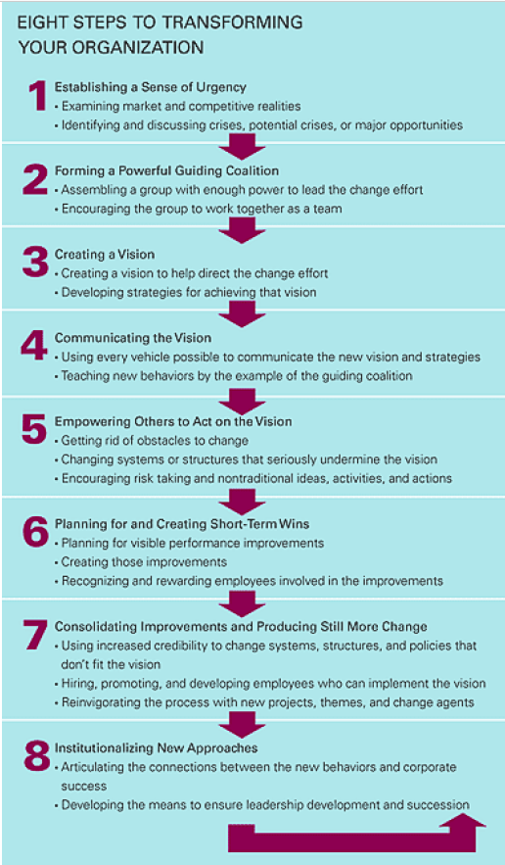
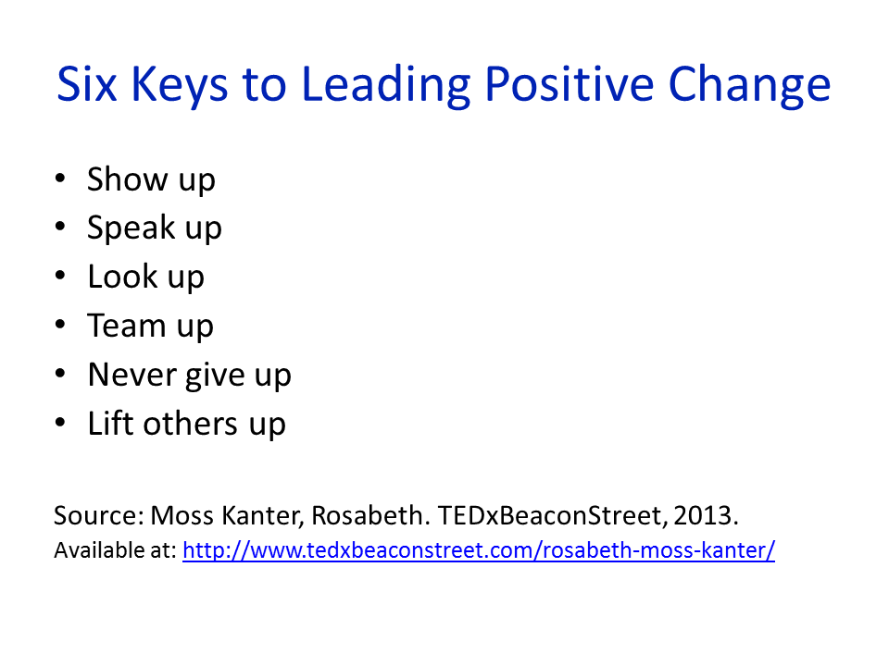
2. Create change
Kotter

Slide 40
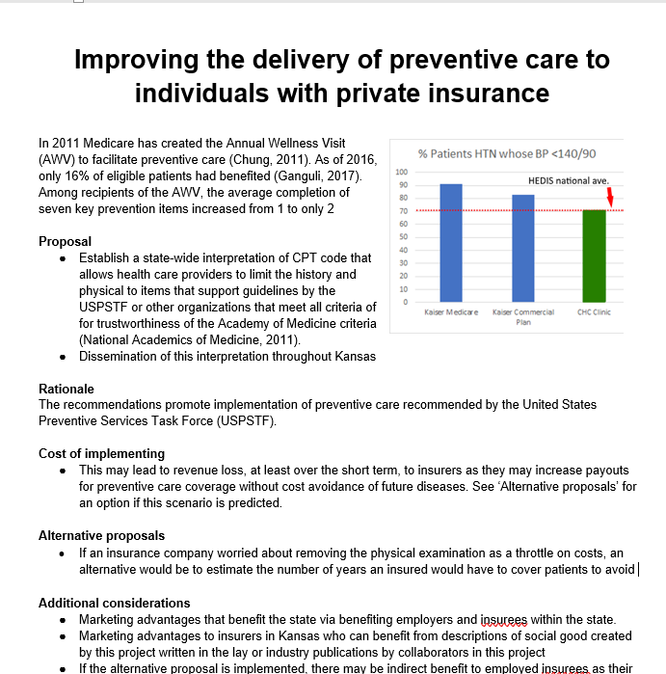
A sample proposal
Aristotle + ‘issue selling’
√
√
√
http://badgettrg.github.io

Slide 41
The annual wellness visit in primary care
Proposal: remove CPT language that suggests a complete physical is needed
Look up – vision
Proposal prepared
Speak up
Phone calls started 08/2019
Show up
Team up
09/2019 – Kansas Healthcare Collaborative
09/2019 – Local physician in private practice
09/2019 – Faculty colleague
10/2019 - MSSC
Lift up
Pending (I hope)
Else, “park & watch”
Monitor relevant newsletters, journals for potential collaborator

Slide 42

Creating change is hard
Kanter’s law
When am I the curmudgeon doctor and when am I constructive?
Fight the good fight
AKA Pick up the litter

Slide 43
3. Be selective where you work
What culture will you look for in your future job?
Regular business meetings that include clinical and workflow improvement and administration (meaningfulness, transparency) (PMID 17891503)
Are the meetings bidirectional? (enfranchisement, autonomy, co-evolution) (PMID 17891503)
“If I have a suggestion for clinical improvement…” what happens? (enfranchisement, autonomy)
Is physician well-being measured and monitored? (PMIDs 19914516, 25384822)

Slide 44
3. Be selective where you work
Manager metrics
Positive deviance
Meetings open and optional
Incentives modernized to a mix of experiential and salary adjustments

Slide 45
4. Voice: a simple way to make a difference
The Medical Director of Emergency Services at hospital 9 described the consequences of the lack of physician leadership on an AMI committee as follows: “[T]here’s not enough physician leadership on the committee. . . . [T]he people who are in charge . . . often show up and there’s no doc there, and they . . . try to implement changes. . . . Every
once and a while they get it a little bit wrong.”
From positive deviance studies (compare Hi and Lo outliers):
Anticoagulation management of outpts (Rose 2012 PMID 27349472)
Hi: “one or more strong quality champions”
Lo: “None of the low outliers had a quality champion.”
Acute MI management (Bradley 2012 PMID 22547471, 21403074)
Hi: “physician and nurse champions”
Lo: “nurse champions alone”
A senior administrator from hospital 2 described the “passion on the part of physician leaders to continually hit that mark and for the best outcomes in the world.”

Slide 46
5. Enable others
Physicians are the worst at this, so… (Stewart. AOM J 2017)
Be positive
Rather than “This is awful”, say “We have an opportunity”
Enable/empower
“What do you think would be best?”
Use “we” rather than me or you
Spontaneously commend good work
In response to an idea: “How can I help”?
But do not burden
Lets ‘empower’ the MAs to do three additional tasks

Slide 47
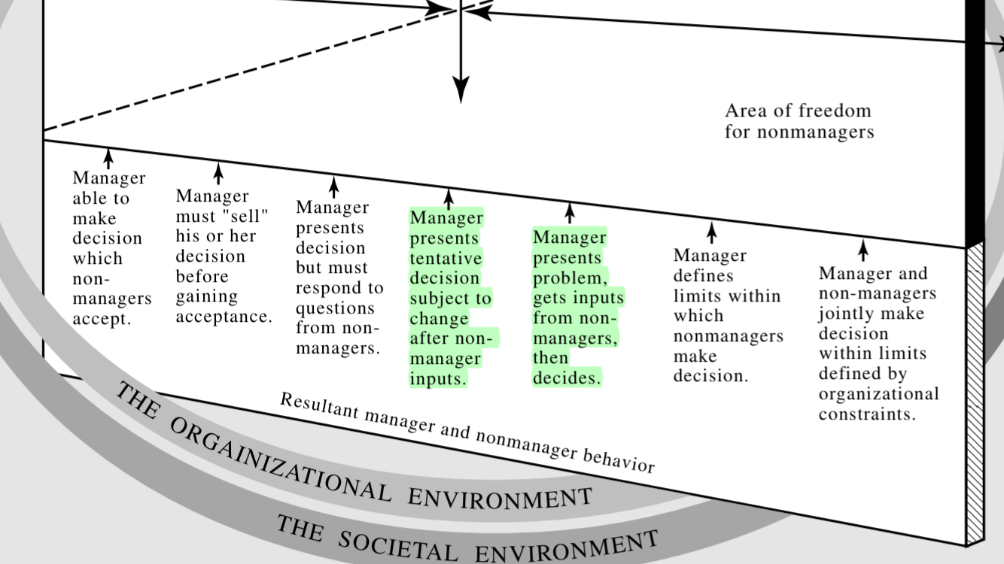
5. Enable others
Tannenbaum. How to Choose a Leadership Pattern. HBR. 1973

Slide 48
6. Resilience
Yoga
Journal and reflection (appreciative)

Slide 49
NHS: Staff surveys
84%
29%
I² = 97%
“I am enthusiastic about my job.”
“During the last 12 months have you felt unwell as a result of work related stress?“
Source: https://www.nhsstaffsurveys.com/Page/1021/Past-Results/Historical-Staff-Survey-Results/

Slide 50
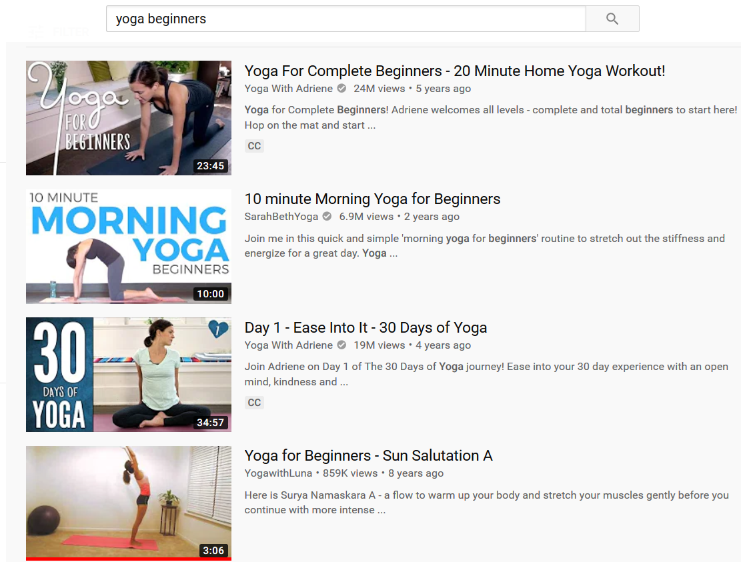
Suggestions for resilience
Yoga
YouTube
Steinberg. 6 Yoga Exercises You Won’t Be Embarrassed to Do at Your Desk. HBR 2015
Cocchiara et al. The Use of Yoga to Manage Stress and Burnout in Healthcare Workers: A Systematic Review. J Clin Med. 2019 PMID: 30813641
End of the day reflection or journal
site:hbr.org keep a journal

Slide 51

Summary
Pickup the litter / fight the good fight.
New types of QI
Change agent, else
Voice, enabling
Voice, positive
Reflection and Yoga
Further reading
HBR and HBS Working Knowledge
Books
Turn the Ship Around!
http://badgettrg.github.io

